Slide 1

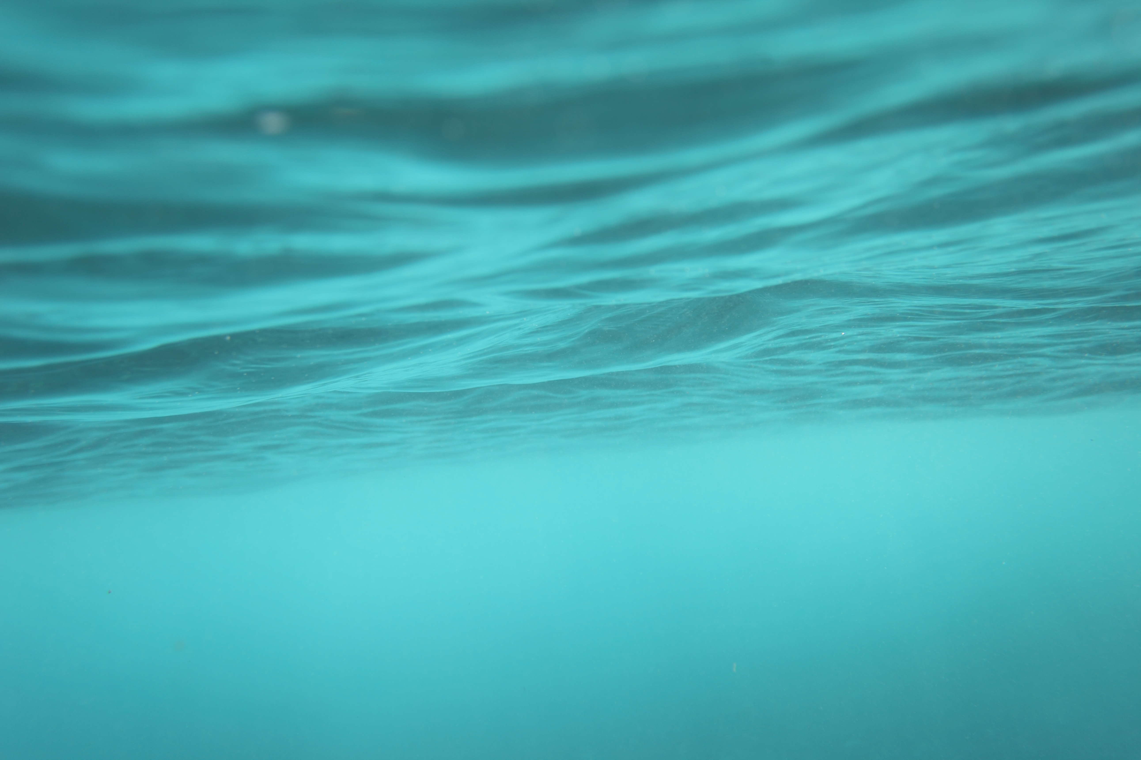
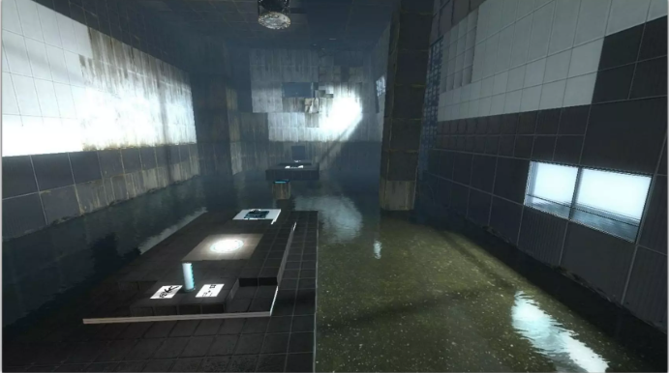
Imitating Water Physics with Texture Distortion and Fake Refraction
Water Flow in Portal 2 – SIGGRAPH 2010, Valve
Ronaldo Cunha
CAP 5727
“Goo” in Portal 2

Slide 2
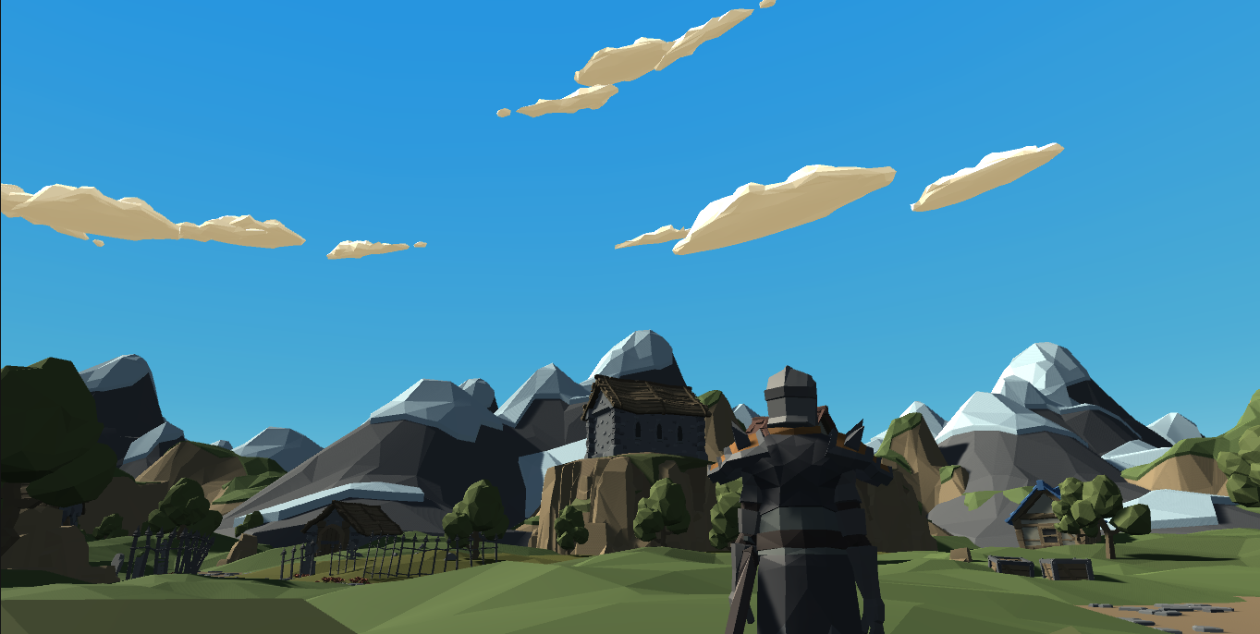
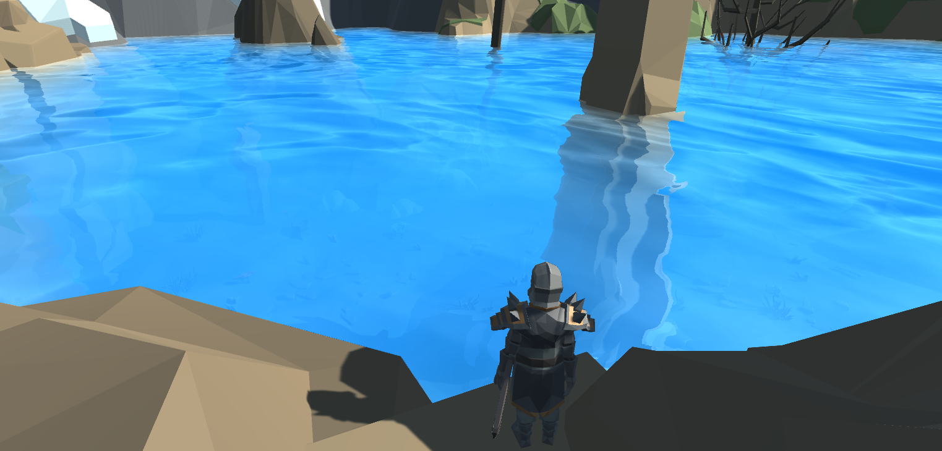
Overview
Goals:
Build a low-poly, third person, open-world scene.
Create a realistic body of water featuring:
Transparency
Refractions
Underwater Fog
Texture-based Distortion
Specular Reflections

Slide 3
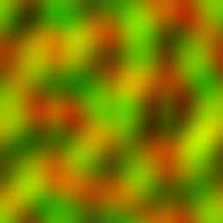
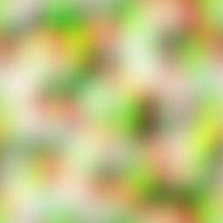
Texture Distortion
Imitate water physics by manipulating UV coordinates.
Generate believable UV flow by varying flow vectors.
Can be encapsulated in a flow map, where U and V components are represented by R and G channels, respectively.
Stretching and distorting – limit flow animation on time range of 0 to 1 since color map will get distorted beyond recognition (reset).
But now it resets every second..
Solution – Blending using a map with Perlin noise, which offsets the time non-uniformly across the surface (phase offset).
Sample two flows from different phases, and blend them
Curl Noise Flow Map
Perlin Noise Flow Map
Noise in A channel
Notes:
This texture distortion through the use of flow vectors can basically be encapsulated in a noise flow map, which basically encapsulates multiple CW and CCW rotating flows, whose vector components U and V are represented by the R and G channels.
We can then sample this flow map to attain a flow vector. We then subtract our UV vector by this flow, which forces the flow in the direction of the flow vector.
Overtime, if unchecked, the texture can become highly distorted and stretched as time goes on, due to the accumulation of UV manipulation of a texture over time.
The solution is to limit the animation really to a time range from 0 to 1 before the high distortion artifacts start becoming clear through the surface. But then, in reality, you have a surface that experiences a repetitive UV manipulation every second, and resets itself. The solution is to fade different parts of the surface non-uniformly over a period of time, and this can be achieved by the use of a perlin-noise flow map, which features noise in the A channel which accomplishes this.
The result is a what seems to be the start of water physics – the water sees visual low points where the “fading” occurs, and high points in the mid-period (highest point of distortion). The “fade to black” is removed by sampling and combining two different flows together one in a cosine-pattern and the other in sine-pattern.
Simulate waves by “jumping” the UV coordinates of the texture. This “jumping” offset is a scalar value we iteratively add to the x and y components of our generated UV vector (taken by subtracting our current UV vector by our sampled flow vector). The result is simulated waves. These jump offsets also control the length of the animation sequence of our combined flow.
We can manipulate how the amount of distortion and flow speed by scaling the sampled flow vectors.
We can change the animation time for a single wave pattern based on the phases of U and V.

Slide 4
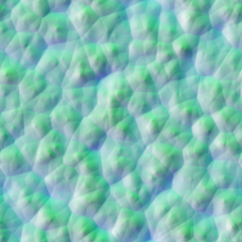
Specular Reflections
Incorporate specular reflections:
An albedo texture for water (generally a noise texture that represents color differentials between the bottom/top of waves).
A normal map (height map of our albedo texture) for animating normals and specular reflection.
What happens if flow strength is zero?
..but a better approach:
Derivative maps store height information in texture space (not dependent on the mesh’s state).
transform normal to height differentials, add them, then convert them back to singular normal.
Which can be stored in a derivative map.
Derivative Map
Notes:
A normal map isn’t appropriate if you have to sample and work with multiple flow vectors at once. What occurs, especially when UV jumps are 0 and Flow Speed (or the flow strength) is reduced to 0, is you get a blinking effect. This occurs because you must average the normals of the two flows, and a normal map stores slope/height information in tangent space, whereas something like a derivative map will store the same information in texture space.. This means you’ve eliminated the dependence on the mesh. So if you were to use a normal map, and the flow strength is 0 (which means our flow vectors are 0 and the water is at a standstill), the dominant flow in a specific region of the mesh would alternate between the two blended flows.. Causing this state change. A derivative map stores the X/Y height derivates in A and G channels, respectively, while also storing the original height map properties in the B channel. We can convert the normal vectors to height derivatives, add them and then convert them back to singular normal vector to do our operations with.

Slide 5
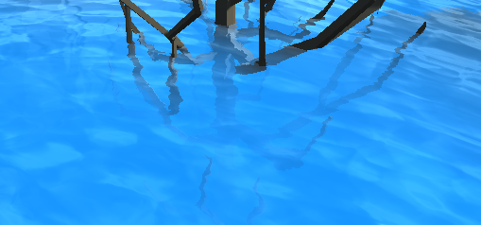
Underwater Fog
Simple to implement.
Water ambient lighting changes the deeper you go (gets bluer).
Implementing fog is the poor man’s version of water light absorption and scattering (but it works).
Find the linear depth difference between the surface depth and background depth.
Generate an exponential fog gradient – fades to blue exponentially as the depth difference increases.
Blend color between the fog and the background.
Notes:
Opaque objects are rendered before transparent ones. Transparent objects also do not write to the depth buffer. Therefore, we can render all opaque objects, grab the final depth buffer, sample the background depth texture, and find the linear depth difference between the surface and background depth. As this difference increases, we gradually increase the fog gradient exponentially.
Then we linearly interpolate the background color between the fog and the sampled background. We also blend in the end, ensuring the alpha of the color increases (gets opaquer) the further deep we go.

Slide 6
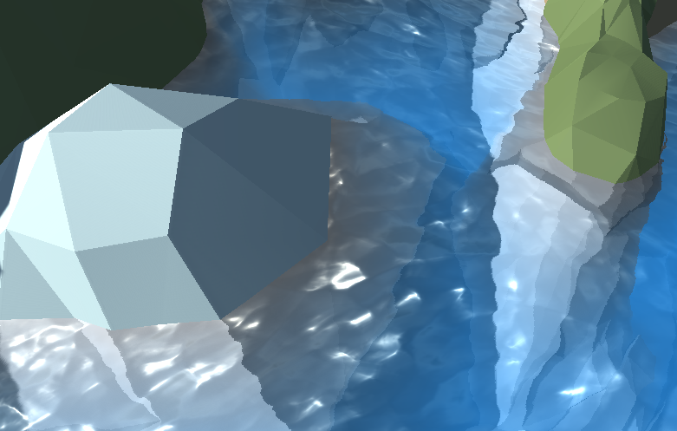
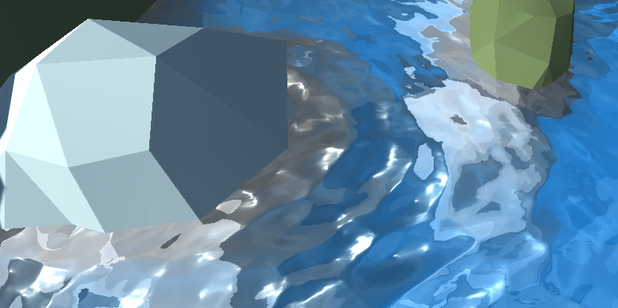
Refractions
Visual feedback through a medium like water changes due to how light changes directions as it contacts the medium.
Can be achieved by grabbing the screen-space data and non-uniformly pulsating the UV coordinates as the surface moves.
Generate a new UV that is a diagonal offset of the original.
Make the offset “jitter” by using the XY coordinates of the surface normal to create this offset.
Can be scaled – refraction intensity is directly proportional to ripple height, which is related to the length of the flow vector (speed).
Low refraction strength
High refraction strength
Notes:
Using the same screen-space data we used for generating fog, we can make simple refractions by effectively “jittering” the UV coordinates underwater.
Simple refractions can be achieved by taking the X Y coordinates of the surface normal vector, and offsetting the UV of the surface in the direction of those coordinates. This can be scaled, and naturally is, since the higher the ripple, the greater the X Y coordinates of the surface normal, thus greater “jittering”. This can be scaled accordingly.
The X and Y components of the normal vector work because they lie in the tangent plane. For a flat surface, they are both zero, which produces no offset, so you can always add a constant refraction term to maintain refraction even at zero UV jumps. The higher the water ripples get, the greater the offset becomes and the stronger the refraction effect gets.

Slide 7
Lessons Learned
What worked:
Careful surface UV distortion through a combined set of blended flows looks believable.
Specular reflections using a derivative map works with blended flows, in all cases.
Believable refractions can be easily achieved by simply “jittering” offsets of surface normals.
What didn’t work:
My initial attempt involved Gerstner Waves and transforming a plane’s geometry – which worked. Incorporating complete refraction and fog was more complex.
Artifacts are rampant in refractions.
This implementation has limitations:
Could never work in an interactive way with environment/player interaction.
Coloration/blending below the water surface is lacking.
By no means physically accurate in any realistic sense.
Notes:
My initial attempt at creating a realistic body of water started with the idea behind a trochoidal or Gerstner wave, where periodic, consistent sets of waves flow through a surface – following the displacement of the surface’s vertices. I was able to successfully generate these waves in a decently complex manner, but incorporating the other things, underwater fog, refraction, etc., was a more complex idea, since Gerstner waves can have multiple waves occurring at different heights on the same plane. This makes the incorporation of fog and refraction tricky since we use tangent-space data to enact those effects, Gerstner waves work on the basis of transforming vertices. That’s not to say refraction/water physics can’t be accomplished for Gerstner waves through different methods.

